Slide 1
How to make effective slides.
Slides are often ineffective or detracts from message being conveyed. Here, we review how to create more effective, accessible, & content-driven slides.

Slide 2
Effective communication is getting your message across
Information → Interpretation → Message
You need audience to both pay attention and then understand your message

Slide 3
Keys for optimizing communication
Adapt to your audience
See the presentation through the eyes of the audience, not the speaker
Reduce noise
i.e., frivolous information or distracting formatting
e.g., too much text
Use effective redundancy
This is the strongest reason for having slides in the first place,
However, the key is in the word effective

Slide 4
Planning Slides
Design your slides in a content-driven manner
Get the message across both verbally and visually
This way the message could be received using either modality
Make good use of prominent title areas
State the message in the title as a sentence

Slide 5
Constructing slides
Template slides are typically noisy
Consider logos & affiliations on title & acknowledgement slides
Add only content that supports your message
Start by asking yourself, “What am I trying to tell people?”
Visual flow: connect text with graphics
Additionally: speak in relation to the visual representation
Ensure text size is not too small
How to check: print slides as handouts (6 per page). Any text that is too small will be too small for your audience.

Slide 6
Presenting your slides
Plan your slides → Structure your slides → Practice!
Be concise: one slide, one message
Interact with your slides
Point out parts of your slide
Know your next slide
Be a speaker, not a guide
Could you give your presentation without your slides? The best way to know, is to practice, practice, practice.

Slide 7
Accessibility Tips
Color contrast – select colors for colorblind & general visibility
Alt text - describe figures and other graphics
Font size - Print large (enough)
Typeface - Use accessible fonts e.g., sans serif
Reading order - Ensure easy flow, cognitive load is exacerbated by disability
Plain English – simple language & spell out acronyms
Resources: Make your PowerPoint presentation accessible Accessibility Guidelines for Presenters

Slide 8
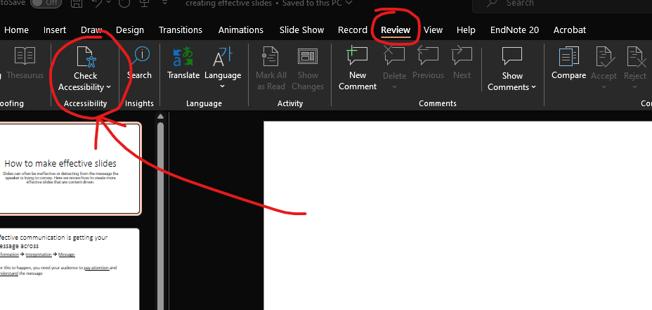
Using the Microsoft accessibility checker
accessibility checker is found under Review --> Check Accessibility

Slide 9
The Visual Display of Quantitative information -- Edward R. Tufte
“What is to be sought in designs for the display of information is the clear portrayal of complexity. Not the complication of the simple; rather the task of the designer is to give visual access to the subtle and the difficult – that is
the revelation of the complex.”

Slide 10
References
Doumont, J. L. (2009). Trees, maps, and theorems. Brussels: Principiae.
Tufte, E. R. (2001). The visual display of quantitative information (Vol. 2, p. 9). Cheshire, CT: Graphics press.
“Make your PowerPoint presentations accessible to people with disabilities” https://support.microsoft.com/en-us/office/make-your-powerpoint-presentations-accessible-to-people-with-disabilities-6f7772b2-2f33-4bd2-8ca7-dae3b2b3ef25
“Write helpful Alt Text to describe images.” https://accessibility.huit.harvard.edu/describe-content-images

Slide 11
Addl’ Resources: Color palettes
Check your color palettes: https://coolors.co
Check your color palettes (adobe): https://color.adobe.com/create/color-accessibility
Color blindness simulator: http://www.color-blindness.com/coblis-color-blindness-simulator/
Example color palettes: https://davidmathlogic.com/colorblind/#%23D81B60-%231E88E5-%23FFC107-%23004D40
Anbuhl 2022 “Tips for accessible and inclusive design practices”

Slide 12
Addl’ Resources: Visualization and Accessibility
https://www.betterment.com/design/accessible-data-visualization
https://towardsdatascience.com/an-incomplete-guide-to-accessible-data-visualization-33f15bfcc400
http://www.inclusivedesigntoolkit.com/UCvision/vision.html#nogo
https://www.brightcarbon.com/blog/optimising-presentations-for-people-with-colour-blindness/
Anbuhl 2022 “Tips for accessible and inclusive design practices”

